Slide 1
Environmental statistics and the green economy – Central Bank’s statistical activities
Robert Kirchner
Member of the Executive, Irving Fisher Committee on Central Bank Statistics (IFC)
Deputy Director General Data and Statistics, Deutsche Bundesbank
Tenth Meeting of the Steering Committee of the Arab Statistics Intitiative (Arabstat) – Abu Dhabi, 8 November 2023

Slide 2
Outline
Where are we?
Central Bank Statistics
New G20 Data Gaps Initiative
What is going on – a window of opportunity?
One conclusion: Data sharing is key

Slide 3
1. Where are we in central bank statistics?
Main outcome of the hybrid IFC Conference on „Statistics for Sustainable Finance“, 14-15 September 2021 in Paris (attended by almost 800 participants, representing about 90 institutions from the public and private sector):
Central banks and financial supervisors have an important role to play in developing sustainable finance statistics. Their main focus has been on establishing analytical frameworks, designing sustainability indicators and actual monitoring.
Central banks/supervisors have become key users of relevant sustainable finance data, with a strong appetite for climate risk-related information. One reason is that global warming and the green transition are affecting a wide range of their policies. In particular, there is a clear link between physical/transition risks and financial stability objectives, for both micro- and macroprudential policy purposes

Slide 4
1. Where are we in central bank statistics?
Addressing sustainable finance data gaps requires careful prioritisation. In the medium to long run, there is a clear need for more comprehensive data sets, with greater consistency and quality.
More and better cooperation between stakeholders is required, especially with the private sector and academia, and between jurisdictions.
Exploiting less conventional data sources and tools might be an important way of bridging existing information gaps.

Slide 5
1. Where are we in central bank statistics? Different user needs and measurement uncertainty: The necessity for a multi-source approach
Emission Data Provider 1
Emission Data Provider 2
Various data providers measuring the same or closely related phenomena reveal measurement uncertainty.
Diverse user needs call for a comprehensive set of indicators and data source to analyse climate risk.
In addition, two different data sources can complement each other in terms of the type of metrics provides, as well as coverage of company level data.
Overlap in company level data available from both providers in one year: 49 % of ISINs

Slide 6
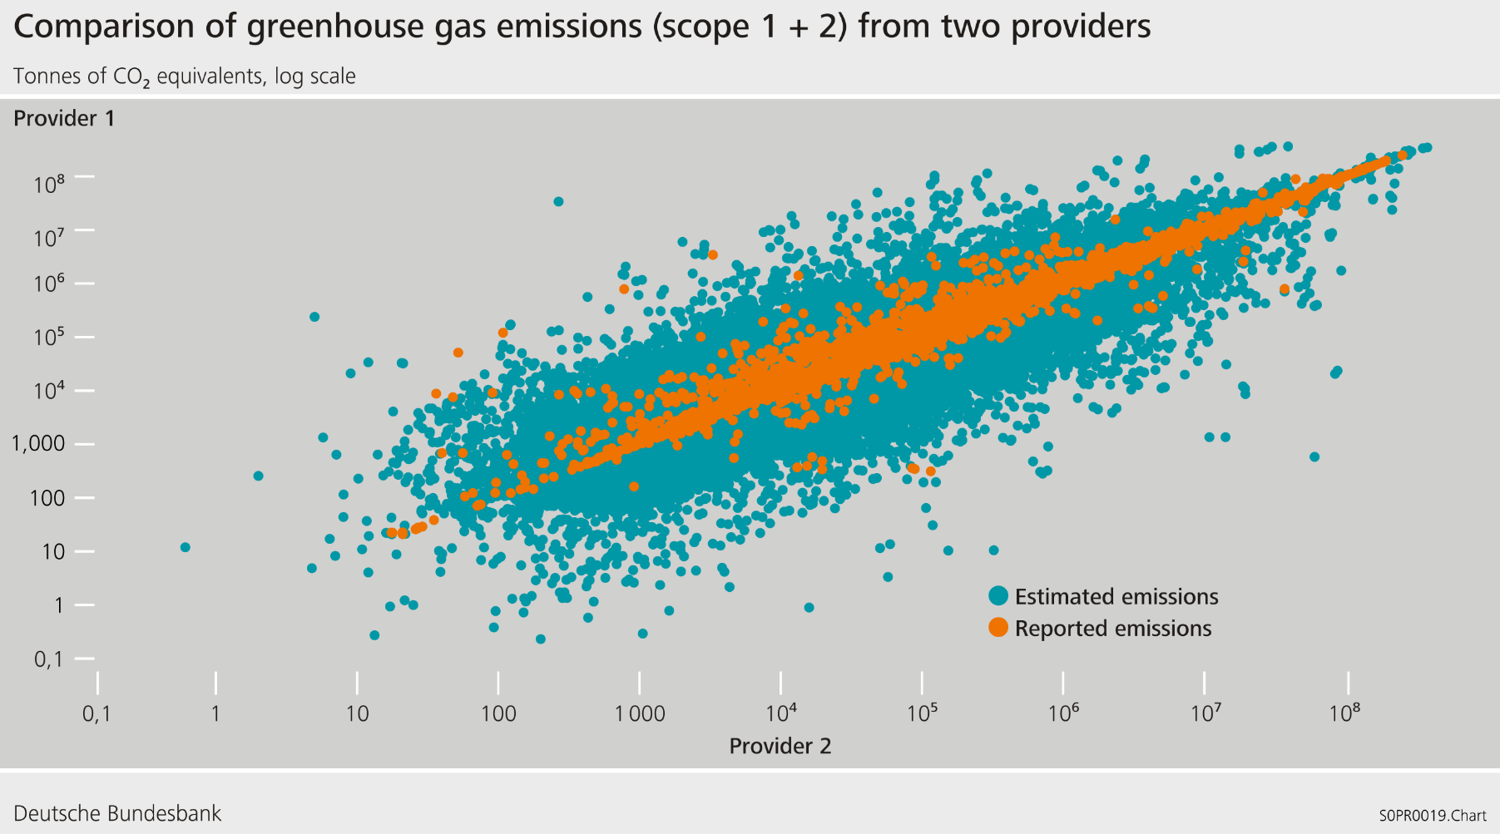
1. Where are we in central bank statistics? Multi-source approach: Allows for robustness checks

Slide 7
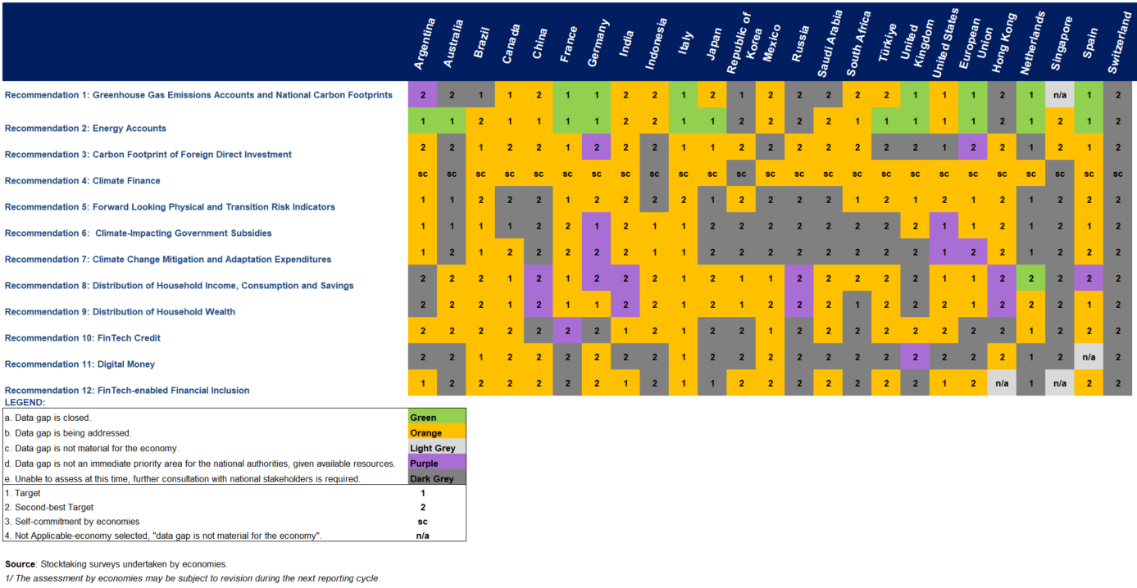
1. Where are we in the new G20 Data Gaps Initiative?
Status of Progress in the Implementation of the DGI-3 Recomendations by G20 and participating economies – as of September 30, 2023

Slide 8
2. What is going on – a window of opportunity? Carbon content measurement for products, organisations and aggregates: creating a sound basis for decision making International workshop organised by the IMF, BIS/IFC, Eurostat, Deutsche Bundesbank, Banco Central de Chile and the University of Oxford Blavatnik School of Government

Slide 9
2. What is going on – a window of opportunity? The idea…
Bringing emissions down is the essence of sustainability policy.
This means bringing down the carbon content of output, on all levels:
Aggregate level (country and sector) G20 Data Gaps Initiative
Company level Standards of the International Sustainability Board (ISSB) EU Legislation, sprecifally Corporate Sustainability Reporting Directive (CSRD) and European Sustainability Reporting Standards (ESRS)
Product level Carbon Accounting – accounting for carbon content of inputs and outputs
To control carbon content, it needs to be measured. Much is under way!

Slide 10
2. What is going on – a window of opportunity? The idea…
Bringing emissions down is the essence of sustainability policy.
This means bringing down the carbon content of output, on all levels:
Aggregate level (country and sector) G20 Data Gaps Initiative
Company level Standards of the International Sustainability Board (ISSB) EU Legislation, sprecifally Corporate Sustainability Reporting Directive (CSRD) and European Sustainability Reporting Standards (ESRS)
Product level Carbon Accounting – accounting for carbon content of inputs and outputs
To control carbon content, it needs to be measured. Much is under way!

Slide 11
2. What is going on – a window of opportunity? The idea…
The analytic concepts of carbon content are essentially the same on all levels, but
ongoing developments on the three levels are somewhat unrelated Aggregate level (country and sector)
If unrelated
the data on different levels will not "talk" to each other;
we will lose the opportunity to cross-validate and …
to estimate missing information using data from other levels.
→ At the workshop, experts on different levels will inform each other on the status quo, the aims, the way forward, and discuss synergies.

Slide 12
2. What is going on – a window of opportunity? The concept…
The workshop is organised by leading questions (being formulated beforehand) around open issues.
Different levels of stakeholders, experts representing:
Statisticians, eg. Input-Output Analysis, Emission Statistics, National Accountants
ESG standard setters, corporate accountants as well as the users of micro data
In-person discussions of invited experts, in plenary and separately, for intensive exchange
Hybrid keynotes and panel discussions for worldwide outreach

Slide 13
2. What is going on – a window of opportunity?
Some of the leading questions
What is the scope of carbon content measurement needed? For companies, countries, sectors?
Who will report, what sort of data will be available, how can they be used?
How shall sectors be formed? How avoid double counting?
What aggregate information does micro level measurement need, and how can aggregate measurement benefit from micro level disclosure?

Slide 14
2. What is going on – a window of opportunity? Organisation
Co-organisers: - IMF
- BIS / Irving Fisher Committee
- Eurostat
- Deutsche Bundesbank
- Central Bank of Chile
- University of Oxford, Blatavnik School of Government
Operating Partner: The E-liability Institute
Location: Hamburg, Germany, Deutsche Bundesbank Regional Office
Time: 21-23 February 2024
Registration:
Carbon content measurement for products, organisations and aggregates: creating a sound basis for decision making | Deutsche Bundesbank
- for online participation -

Slide 15
3. One conclusion: Data sharing is key
The IFC organized a session on Sustainable Finance Statistics at the 64th ISI World Statistics Congress – Ottawa, Canada in July 2023. Key takeaways:
No institution has all the relevant climate, financial and non-financial data at hand
Data-sharing between institutions, in particular central banks and statistical offices are key

Slide 16
3. One conclusion: Data sharing is key
The IFC Guidance Note 3 – Data-sharing practices is based on the reported experience from the IFC network on central banks’ data-sharing practices. It reviews a number of specific issues, related in particular to:
ongoing initiatives to promote data-sharing
the use of common statistical identifiers and agreed standards
national practical experiences to share granular data
the balance between confidentiality and users’ needs.

Slide 17
References
G20 (2023): People. Planet. Economy. Third Phase of the G20 Data Gaps Initiative (DGI-3). First Progress Report.
IFC (2021): The Bundesbank‘s Sustainable Finance Data Hub (presentation given at the International Conference on „Statistics for Sustainable Finance“, Maurice Fehr, Christine Schlitzer and Elena Triebskorn, Deutsche Bundesbank). URL: https://www.bis.org/ifc/publ/ifcb56_15.pdf
IFC (2022): IFC Bulletin. No 56. Statistics for Sustainable Finance. URL: https://www.bis.org/ifc/publ/ifcb56.pdf
ISI (2023): 64th ISI World Statistics Congress – Ottawa, Canada. URL: https://www.isi2023.org/conferences/15/programme/

